Slide 1
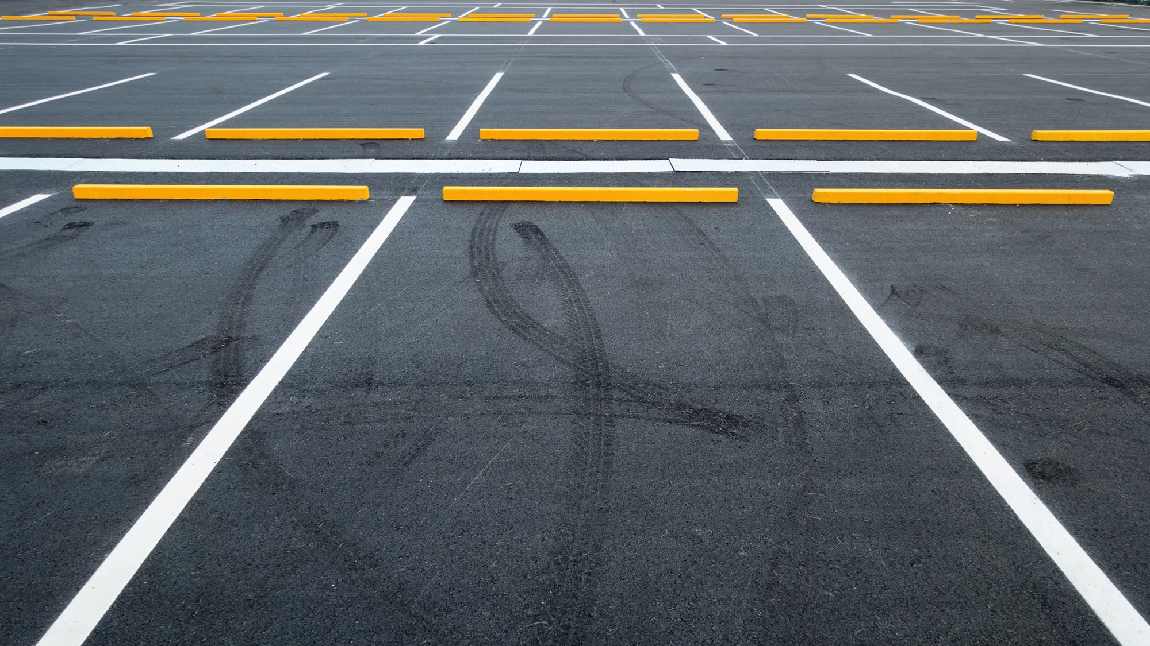
Smart Park
By Damian Avery

Slide 2
Project
Create an application that can direct students and faculty to an open parking stall.
Benefits
Improve traffic.
Increase on time attendance.
Incentivizes parking permit purchases.
Requires
App (CS)
Sensor package (EE)
Data infrastructure (EECS)

Slide 3
Execution (EE)
LoRa protocol
Node
Gateway
Sensor Package (Node)
Tandem sensors (MPU9250, VL53L0X)
LoRa microcontroller (MKR WAN 1310)
Battery (Li-ion, LTC)
Housing (protect equipment meeting NEMA IP ratings)
Code / Logic
Class B device

Slide 4

Role (Signal Integrity)
Improve signal quality
Develop and execute Test Plan
Derive conclusion
Improve hardware (uni-directional antenna 915, change LoRa transceiver CMWX1ZZABZ)
Boost power
(Code: PA_Boost pin → 20dBm)
Create gateway

Slide 5
Relevancy
Applied ECE fundamentals
Understanding of Electromagnetism (magnetometer)
Understanding of Communication systems
Boosting a signal
Modulation & demodulation
Signal type (Power, Energy, Analog, Digital)
Applied EECS fundamentals
Implementation of Logic Digital Design
Understanding of code Intro to C++, Object Oriented Programming

